Slide 1

Diving into NestJS: Building Enterprise Web Applications
COURSE - - - NestJS – NodeJS Framework

Slide 2
Agenda for today
Why NestJS
Dependency Injection & Decorators
Core NestJS Entities: Modules, Controllers, Providers
Additional NestJS Entities: Guards, Filters, Interceptors, Pipes
Nest CLI
Data validation & Databases
Auth in NestJS

Slide 3

Guard
Guard is a class annotated with the @Injectable() decorator, which implements the CanActivate interface

Slide 4
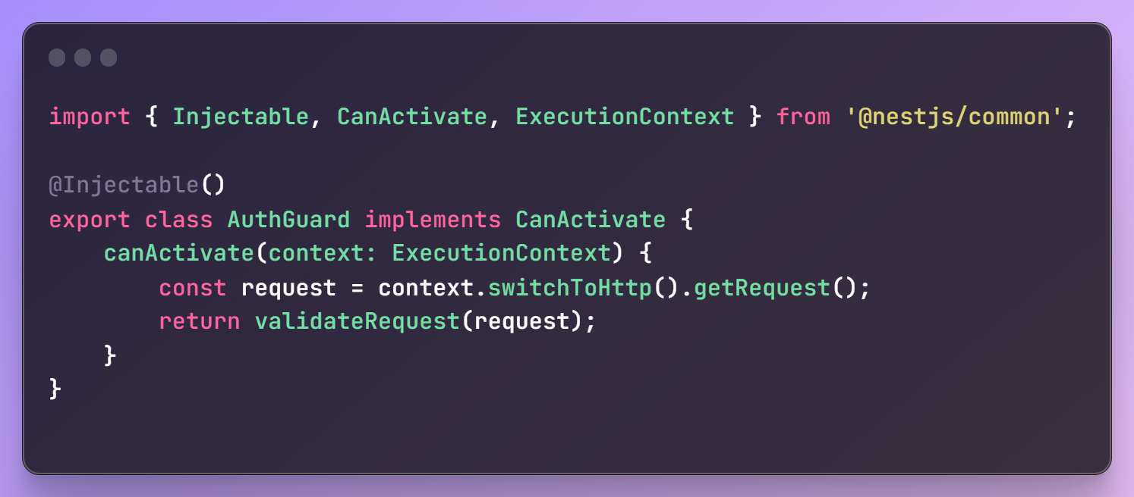
Guard

Slide 5

Pipe
Pipe is a class annotated with the @Injectable() decorator, which implements the PipeTransform interface.

Slide 6
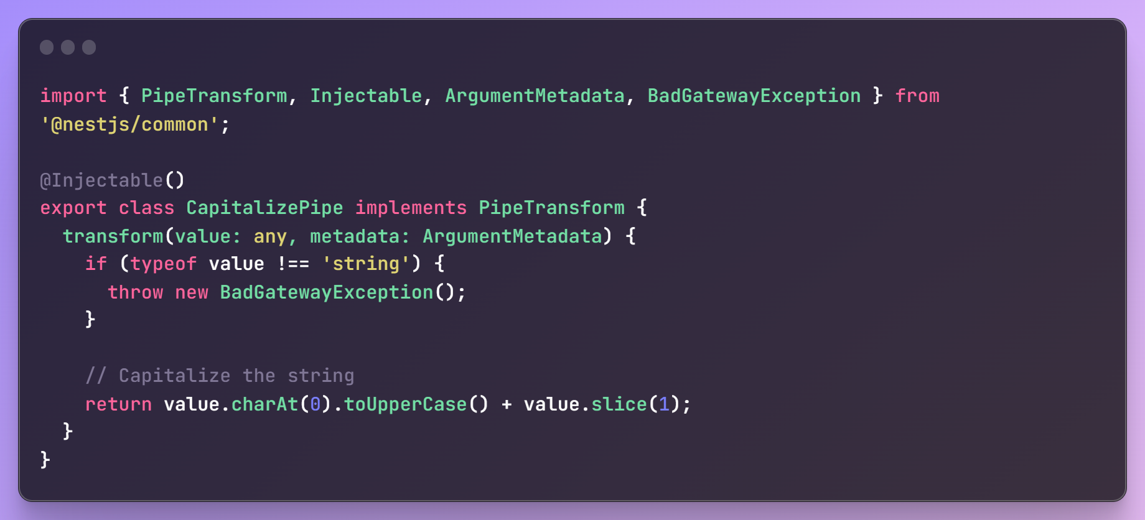
Pipe

Slide 7

Interceptors
Interceptor is a class annotated with the @Injectable() decorator and implements the NestInterceptor interface.

Slide 8
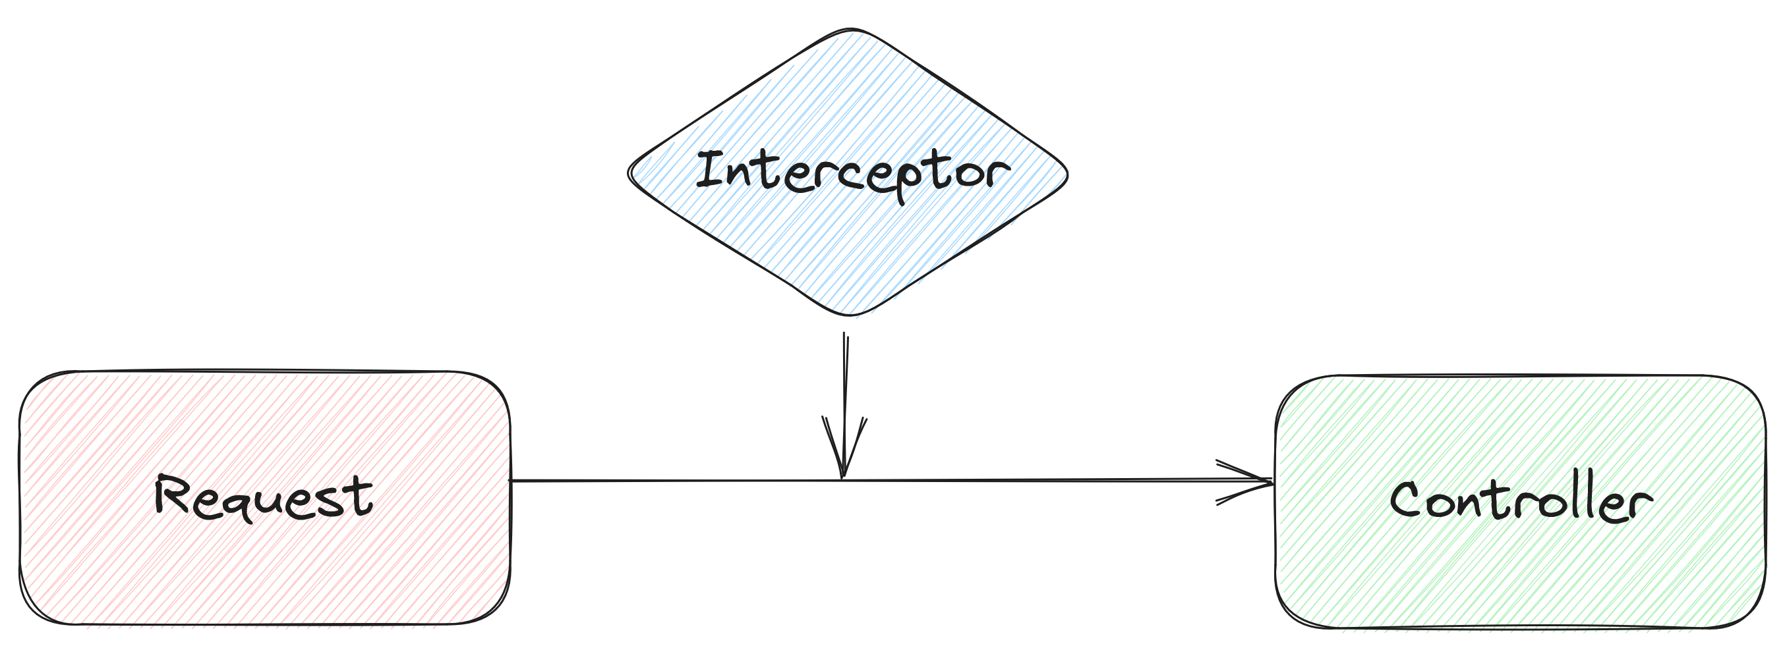
Interceptors
- Log incoming requests
- Log outgoing responses
- Transform/modify incoming requests
- Transform/modify outgoing responses
- Validate incoming requests
- Validate body of incoming requests
- Transform errors that are thrown

Slide 9
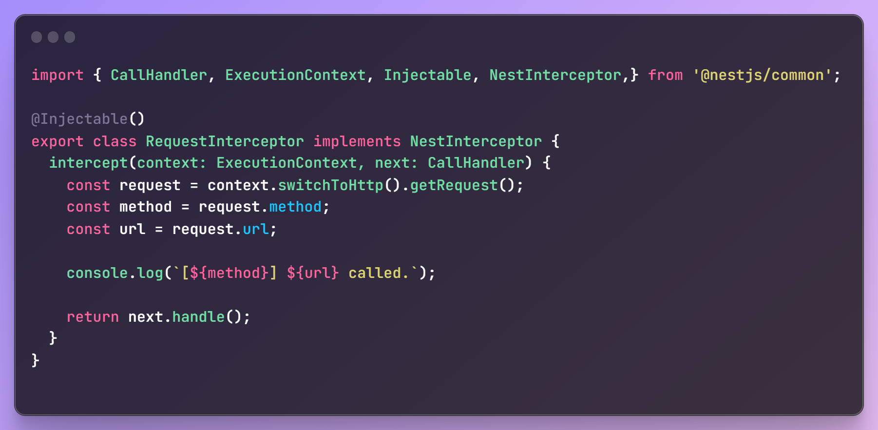
Interceptors
Here, we “intercept” the requests and then print out the method and URL.

Slide 10

Exception Filter
Exception Filter is a specialized class that helps in handling exceptions that occur during the processing of requests and responses

Slide 11
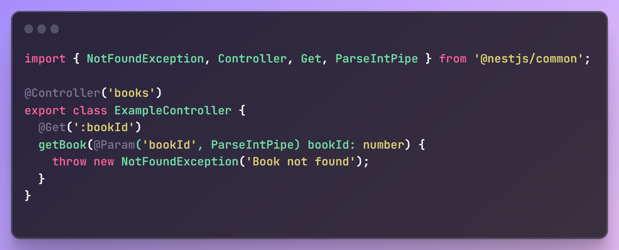
Exception Filter
NestJS has a build-in global exception filter that handles exceptions of type HttpException

Slide 12
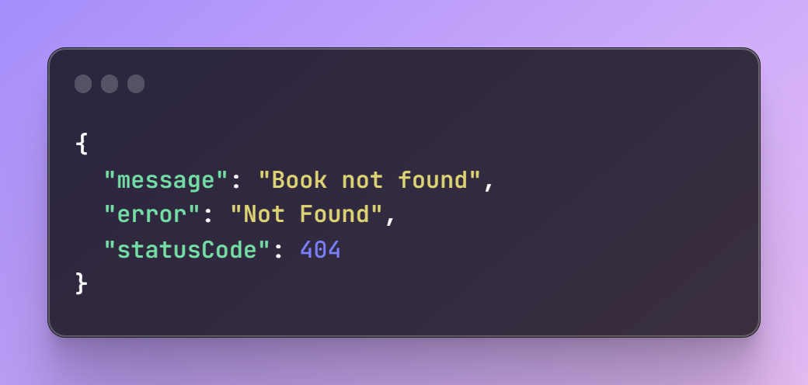
Exception Filter
As a result, we have a nice error response for the client

Slide 13
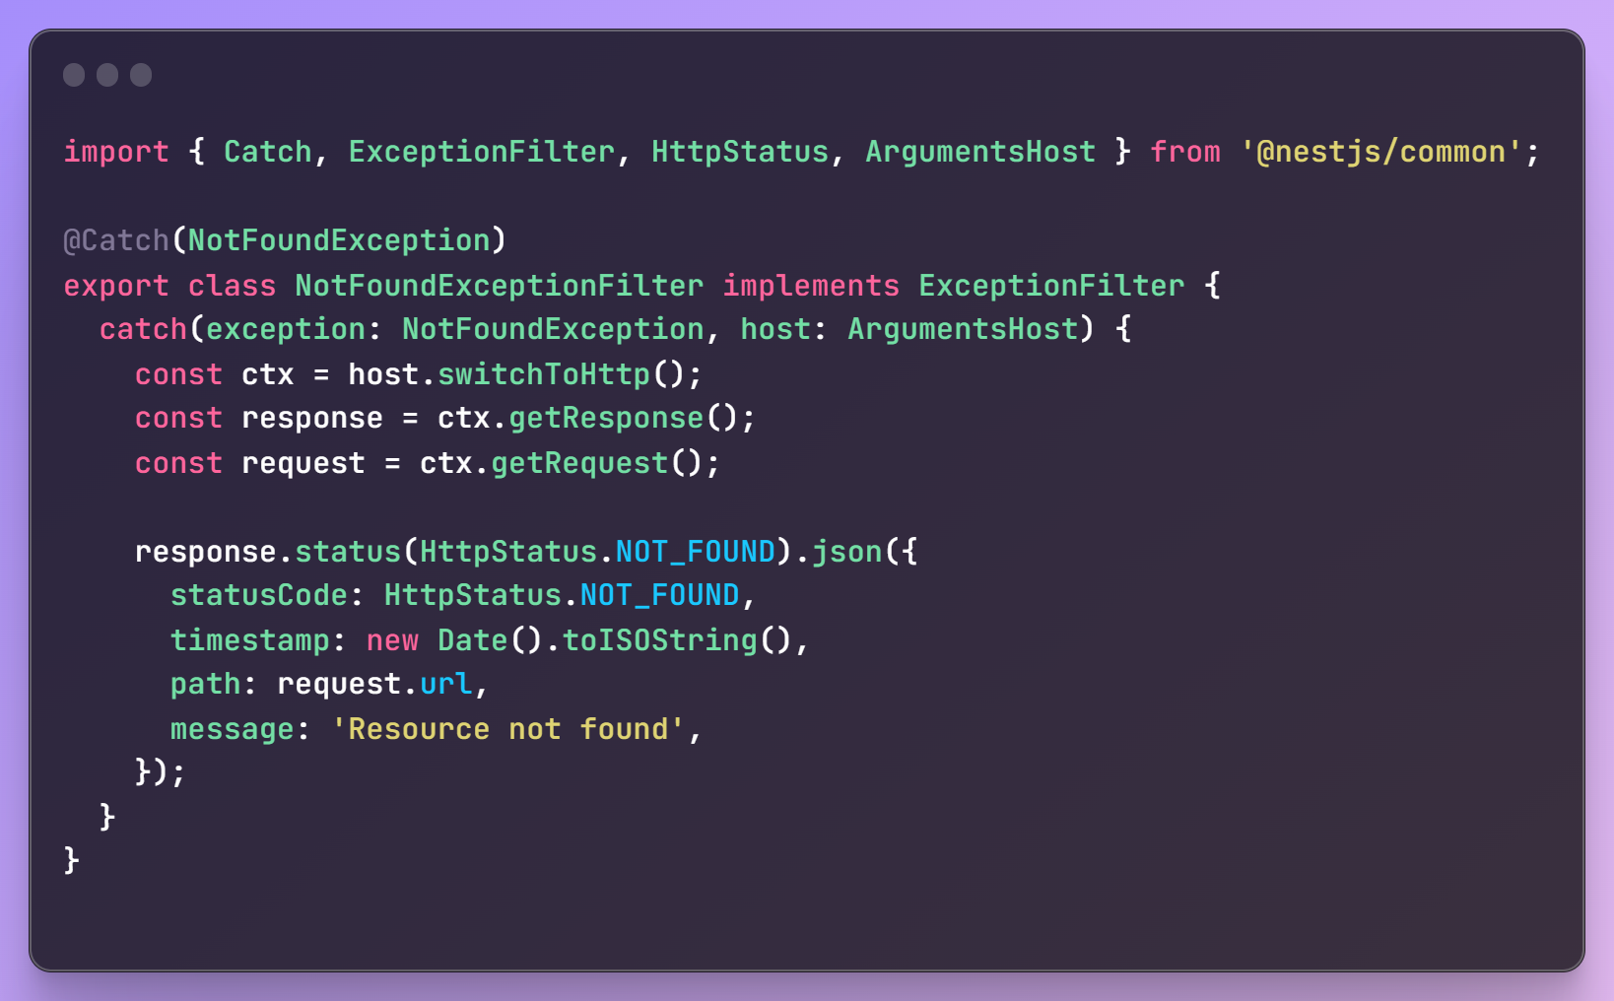
Exception Filter - Example
We can create custom exception filters and modify the returned response with error by using @Catch decorator

Slide 14

Nest CLI
Nest CLI is a command-line interface tool that helps you to initialize, develop, and maintain your Nest applications

Slide 15
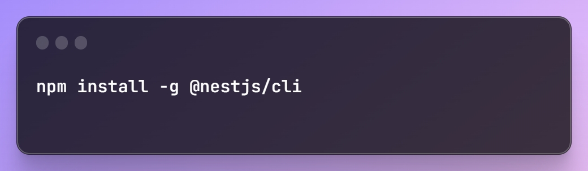
Nest CLI - Installation

Slide 16
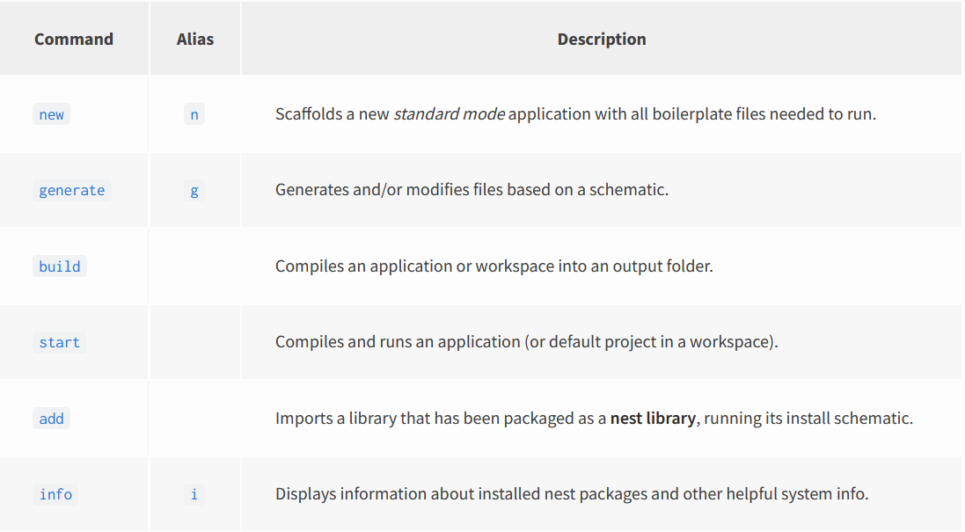
Nest CLI - Commands

Slide 17



Data validation
Data validation plays a crucial role in ensuring the integrity and security of the information being processed
Injection Attacks
Invalid Inputs
Data Integrity

Slide 18
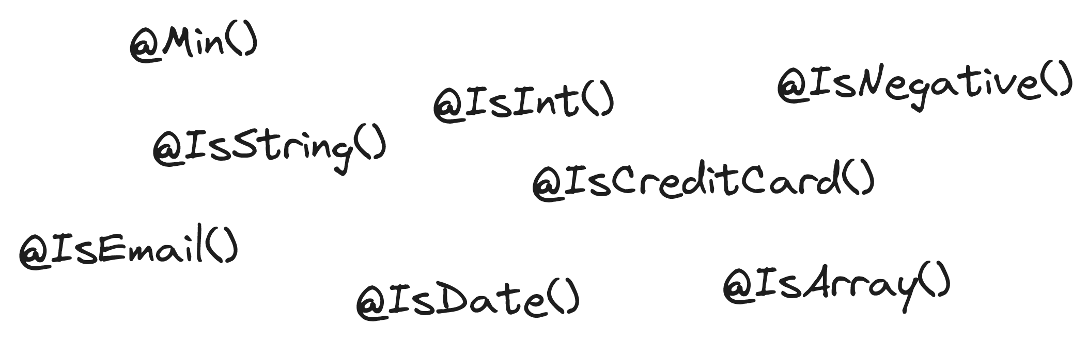
Data validation - DTO
DTO means Data Transfer Object. In NestJS, DTOs are used to validate incoming data with the help of decorators from class-validator package

Slide 19
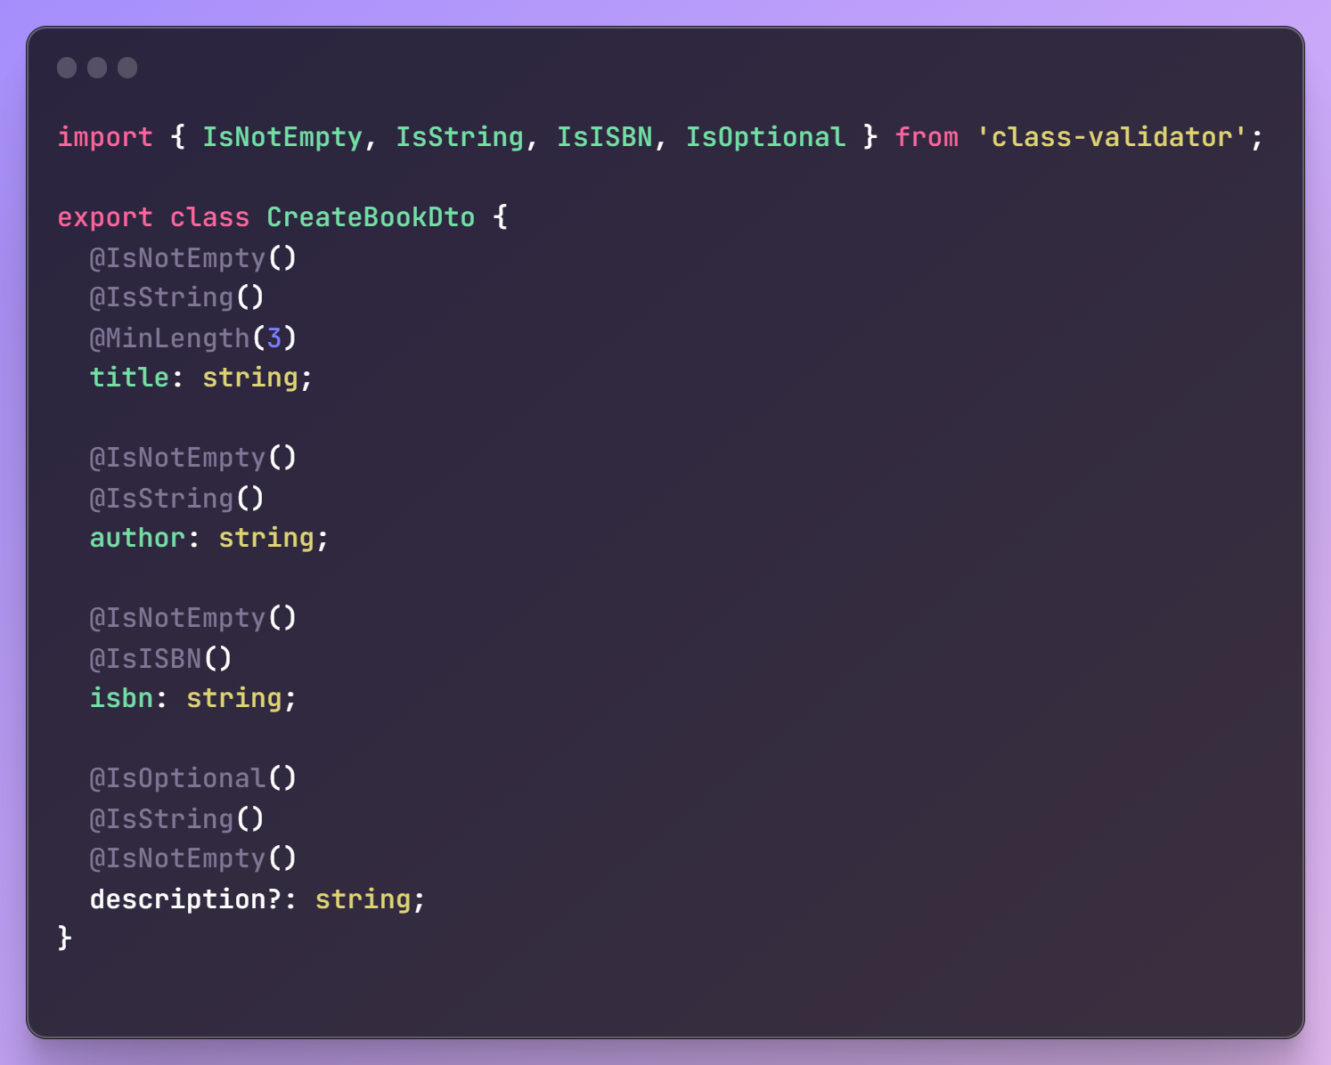
Data validation - DTO Example

Slide 20
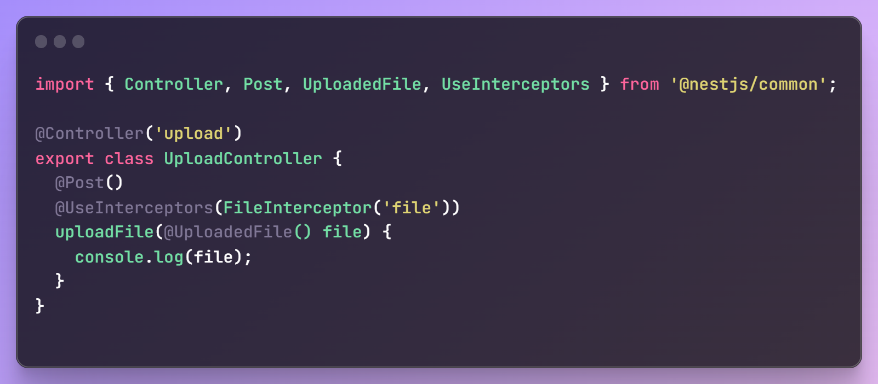
File upload
With FileInteceptor and @UploadedFile decorator, we can get uploaded files

Slide 21
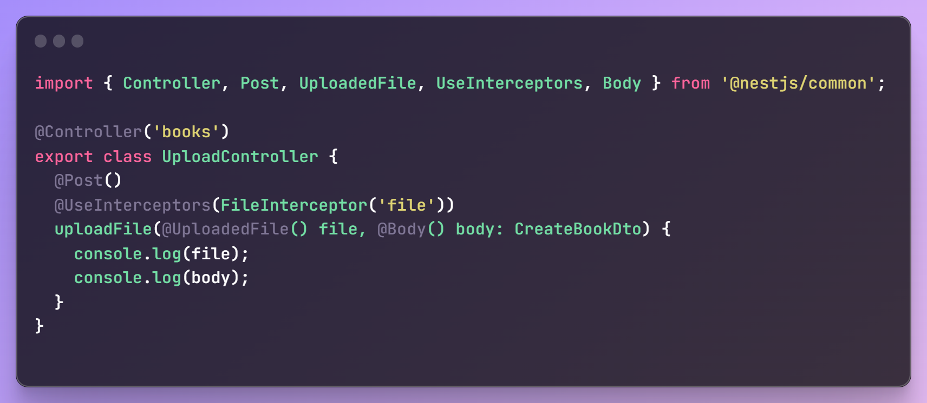
File upload - With Body
We can easily combine file upload with @Body decorator

Slide 22
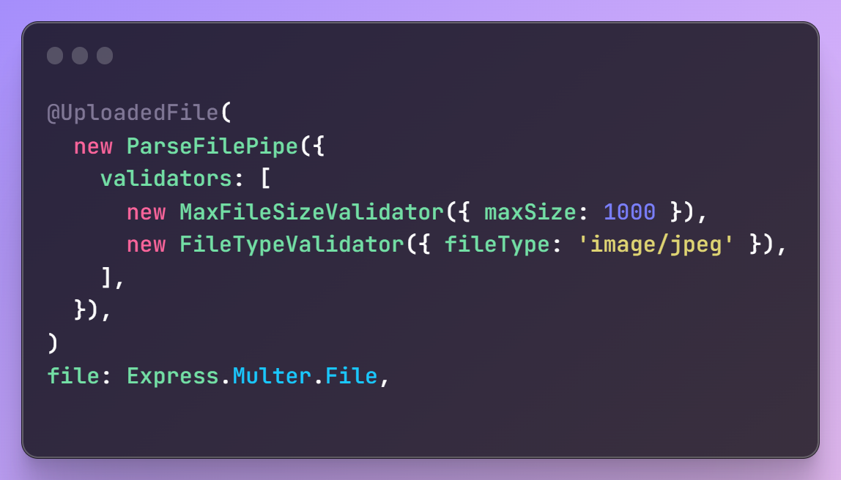
File upload - File Validation
NestJS provides us with classes to validate incoming files with special ParseFilePipe

Slide 23





NestJS and Databases
NestJS is database agnostic, which means that we can easily integrate it with any SQL or NoSQL database

Slide 24





NestJS and Databases – ORM/ODM
In addition, you can integrate popular ORM/ODM with NestJS via ready modules

Slide 25

Authentication and Authorization
Authentication
It is answering to question “Who you are?”
Authorization
It is answering to question “What can you do?”

Slide 26

Authentication
NestJS supports a variety of different authentication techniques:
- Session (Local)
- JWT
- OpenID
- OAuth

Slide 27
Authentication - Patterns
Common patterns for authentication in NestJS:
- Dedicated module for authentication
- Auth strategy/ies
- Auth guard

Slide 28

Authorization
NestJS supports a variety of different authorization techniques:
- Role-based access control (RBAC)
- Claims-based access control (CBAC)
- Attribute-based access control (ABAC)
- Etc.

Slide 29





Security
Authentication is Authorization are not the only things in security!
Encryption and hashing
Validation
CORS
Logging
Vulnerabilities and exploits
Rate limiting

Slide 30

Security - Encryption and hashing
Encryption the process of converting human-readable plaintext to unreadable text, also known as ciphertext
Two types of encryption:
- Symmetric
- Asymmetric

Slide 31

Security - Encryption and hashing
Hashing is the process of converting a given key into another value. In NestJS, we can use libraries such as “bcrypt” and “argon2”

Slide 32

Any questions?
Thank you very much!

